Slide 1
A C++ MQTT Message Broker for the Enterprise
John Dubchak
Castlight Health Inc.
Copyright © 2016

Slide 2
Agenda
Shameless self-promotion
Overview of Messaging
Basic messaging concepts
Enterprise Messaging
The MQTT Messaging Protocol
Designing and Implementing an MQTT Broker

Slide 3
About me

Slide 4
Messaging overview
The Basics

Slide 5
What is Messaging?
The communication of data from sender to receiver over a given messaging channel in an agreed upon format of exchange

Slide 6
What is Messaging?
The communication of data from sender to receiver over a given messaging channel in an agreed upon format of exchange

Slide 7
What is Messaging?
The communication of data from sender to receiver over a given messaging channel in an agreed upon format of exchange

Slide 8
What is Messaging?
The communication of data from sender to receiver over a given messaging channel in an agreed upon format of exchange

Slide 9
What is Messaging?
The communication of data from sender to receiver over a given messaging channel in an agreed upon format of exchange

Slide 10
What is Messaging?
The communication of data from sender to receiver over a given messaging channel in an agreed upon format of exchange

Slide 11
What is Messaging?
The communication of data from sender to receiver over a given messaging channel in an agreed upon format of exchange

Slide 12
What is Messaging?
The communication of data from sender to receiver over a given messaging channel in an agreed upon format of exchange

Slide 13
The Canonical Messaging Model
Notes:
The key things to note here are
The client
The server
The messaging channel
And the implicit formatted data between both the client and the server
The arrow directions, in the diagram, shows the direction of message flow: the request is sent by the client to the server and the acknowledgement is sent back from the server to the client

Slide 14
Styles of communication
Messaging Architecture
Notes:
The key to Messaging is that the underlying concepts are based on the fundamental principle of Message Exchange Patterns (MEP), though we may not always use this terminology.
In this particular section we’ll look at several difference architectural styles of messaging and start narrowing down the underlying principles that move us closer to the style specified by the MQTT protocol.

Slide 15
Point-to-Point Messaging
T₀
T₁
T₂
T_{N}
Notes:
Most of you will be familiar with point-to-point as Queuing, where a single producer sends a message to a receiver. The receiver may not be capable of immediately handling it and therefore queues the message for later processing.
Queues are FIFO data processing pipelines and can, when matched appropriately with a scaled number of workers can provide efficient processing.
You’ll notice that the canonical model can serve as a basic FIFO design where the server endpoint is providing FIFO processing.
The publisher of the message is referred to as the sender.
What makes point-to-point or queuing unique is that in queuing systems, a message is only capable of being consumed by a single consumer, often called the receiver.

Slide 16
Request-Response
T₀
T₁
T₂
T₃
T₄
T_{N}
Notes:
Request and response is an precise implementation of the Canonical model.
Many of you already recognize it as client server communications and quite literally that’s all it really is.
The sender sends a message to the Receiver, in this case we have labeled the receiver as the Server in this diagram and blocks waiting for a response.
We can assume that some amount of processing occurs on the servers before a response is sent back from Receiver to Sender.

Slide 17
Request-Callback
T₀
T₁
T₂
T₃
T₄
T_{N}

Slide 18
Actor Model
“The actor model in computer science is a mathematical model of concurrent computation that treats actors as the universal primitives of concurrent computation.”
https://en.wikipedia.org/wiki/Actor_model
Notes:
The Actor is a fully encapsulated component with direct communication and asynchrony
There is no strict ordering of messages
A single Actor represents a fully complete communication and data encapsulation
A big difference is that Actors are capable of creating other Actors, for instance in the case of resumption

Slide 19
Publish-Subscribe
T₀
T₁
T₂
T₃
T₄
T_{N}

Slide 20
Enterprise messaging
Notes:
Before we move into MQTT. Let’s just talk, briefly, about how these messaging styles relate to Enterprise Messaging.

Slide 21
What is Enterprise Messaging?
A suite of tools providing:
Business Process Orchestration
Systems and Data Integration
Monitoring
Transformation/Routing
Logging
You may see MSMQ, IBM MQ Series, JMS Technologies
Systems are either heterogeneous or homogenous
Notes:
So, what do I mean when I say Enterprise Messaging?
Admittedly it’s an overloaded term. And every Vendor’s marketing department defines it more specifically tailored to their product suite than the next. <CLICK>

Slide 22
Architectural Attributes
Highly Available
Fault tolerant
Secure
Redundant
Reliable/Delivery Retry
Guaranteed Message Delivery
Message Ordering
Client Session Management

Slide 23
THE MQTT protocol
The Messaging Layer

Slide 24
What is MQTT?
Message Queue Telemetry Transport
Pub/Sub Message Protocol
Standardized in OASIS & ISO
Lightweight
Constrained Vocabulary
Notes:
If messaging where a Domain Specific Language, you might say that it had a constrained vocabulary.

Slide 25
Protocol Requirements
Integer data values are 16-bits in Big-Endian order
All text is UTF-8 encoded strings
All strings are prefixed with a two byte length
Strings are limited to 65,535 bytes
Character data must be well-formed
The NULL character ‘\0’ is not permitted in String data

Slide 26
Message Types
Connect
Subscribe
Unsubscribe
Publish
PubRel
PubComp
PingReq
Disconnect
ConnAck
Suback
Unsuback
Puback
PingResp

Slide 27
Mqtt messaging use-cases

Slide 28






Internet of Things
Broker

Slide 29
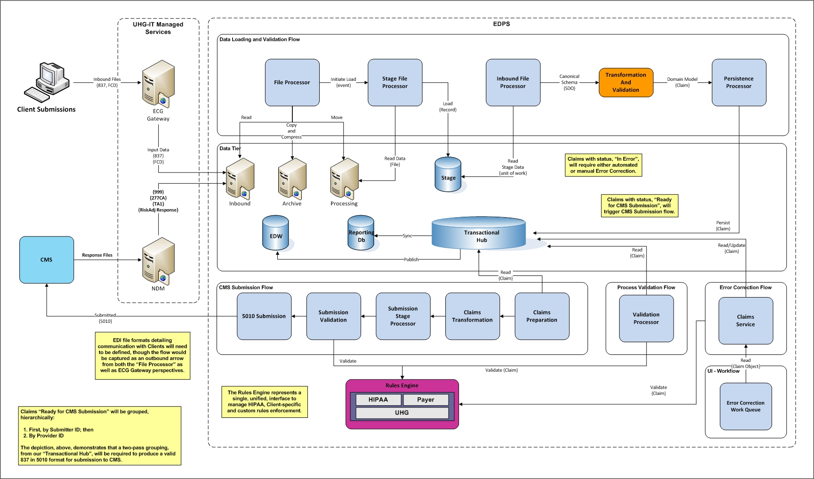

Slide 30
Mqtt client connect to broker
Making a connection

Slide 31
MQTT Connect

Slide 32
MQTT Client Connect

Slide 33
MQTT abstractions
PODs Used for Protocol Connect Data Communications

Slide 34
struct Connect {
std::uint8_t type : 4;
std::uint8_t : 4;
std::uint8_t length : 8;
char* protocol;
char* level;
union {
unsigned char all;
struct {
std::uint8_t : 1;
std::uint8_t cleanSession : 1;
std::uint8_t will : 1;
std::uint8_t qos : 2;
std::uint8_t will_retain : 1;
std::uint8_t password : 1
std::uint8_t username : 1;
} flags;
} bits;
char* clientId;
char* topic;
char* message;
char* username;
char* password;
};

Slide 35
struct Connect {
std::uint8_t type : 4;
std::uint8_t : 4;
std::uint8_t length : 8;
char* protocol;
char* level;
union {
unsigned char all;
struct {
std::uint8_t : 1;
std::uint8_t cleanSession : 1;
std::uint8_t will : 1;
std::uint8_t qos : 2;
std::uint8_t will_retain : 1;
std::uint8_t password : 1
std::uint8_t username : 1;
} flags;
} bits;
char* clientId;
char* topic;
char* message;
char* username;
char* password;
};

Slide 36
struct Connect {
std::uint8_t type : 4;
std::uint8_t : 4;
std::uint8_t length : 8;
char* protocol;
char* level;
union {
unsigned char all;
struct {
std::uint8_t : 1;
std::uint8_t cleanSession : 1;
std::uint8_t will : 1;
std::uint8_t qos : 2;
std::uint8_t will_retain : 1;
std::uint8_t password : 1
std::uint8_t username : 1;
} flags;
} bits;
char* clientId;
char* topic;
char* message;
char* username;
char* password;
};

Slide 37
struct Connect {
std::uint8_t type : 4;
std::uint8_t : 4;
std::uint8_t length : 8;
char* protocol;
char* level;
union {
unsigned char all;
struct {
std::uint8_t : 1;
std::uint8_t cleanSession : 1;
std::uint8_t will : 1;
std::uint8_t qos : 2;
std::uint8_t will_retain : 1;
std::uint8_t password : 1
std::uint8_t username : 1;
} flags;
} bits;
char* clientId;
char* topic;
char* message;
char* username;
char* password;
};

Slide 38
struct Connect {
std::uint8_t type : 4;
std::uint8_t : 4;
std::uint8_t length : 8;
char* protocol;
char* level;
union {
unsigned char all;
struct {
std::uint8_t : 1;
std::uint8_t cleanSession : 1;
std::uint8_t will : 1;
std::uint8_t qos : 2;
std::uint8_t will_retain : 1;
std::uint8_t password : 1
std::uint8_t username : 1;
} flags;
} bits;
char* clientId;
char* topic;
char* message;
char* username;
char* password;
};

Slide 39
Connection Flags
Flag Name | Purpose
Clean Session | 0: MUST resume communication based on current session of Client Identifier
Will | 1: If connection is accepted a message must be stored that is delivered upon subsequent disconnection 0: No message is to be stored
Will QoS | If Will Message is 0, Will QoS MUST be 0. If Will Message is 1, Will QoS can be either 0 (0x00), 1 (0x01), or 2 (0x02)
Will Retain | Broker should retain Will Message or not
Password | 0, password must not be present, 1 it is
User Name | 0, user name must not be present, 1 it is

Slide 40
struct ConnAck {
std::uint8_t type : 4;
std::uint8_t : 4;
std::uint8_t length : 8;
std::uint8_t : 7;
std::uint8_t session : 1;
std::uint8_t return_code : 8;
};
* Session and return code are only used in ACK
Notes:
If Server accepts a connection with Clean Session set to 1, the Server MUST set Session Present to 0.
If the Server accepts a connection with Clean Session set to 0, the value set in Session Present depends on whether the Server has a stored state or not.
Non-zero return code, Session Present MUST be set to non-zero

Slide 41
struct ConnAck {
std::uint8_t type : 4;
std::uint8_t : 4;
std::uint8_t length : 8;
std::uint8_t : 7;
std::uint8_t session : 1;
std::uint8_t return_code : 8;
};
* Session and return code are only used in ACK
Notes:
If Server accepts a connection with Clean Session set to 1, the Server MUST set Session Present to 0.
If the Server accepts a connection with Clean Session set to 0, the value set in Session Present depends on whether the Server has a stored state or not.
Non-zero return code, Session Present MUST be set to non-zero

Slide 42
CONNACK Return Codes
Value | Return Code Response | Description
0 | 0x00 Connection Accepted | Connection Accepted
1 | 0x01 Connection Refused | Unsupported MQTT Level
2 | 0x02 Connection Refused, Identifier Rejected | The Client Identifier is correct UTF-8 but not permitted
3 | 0x03 Connection Refused, Server Unavailable | The MQTT Service is unavailable
4 | 0x04 Connection Refused, Bad username or password | Data in the user name or password is malformed
5 | 0x05 Connection Refused, Not Authorized | Client not authorized to connect
6 – 255 |  | Reserved for future use

Slide 43
MQTT Broker
Component Design

Slide 44
Preliminaries
Templates, templates, templates
Policy-based Design
Moderate use of Template Metaprogramming
Implementation based upon First Principles
Implemented as a daemon on Linux
Personal research project exploring MQTT

Slide 46
Implementation details

Slide 47
Broker
template<typename HANDLE,
template <typename>
class Acceptor = Accept>
class MqttBroker : public BasicDaemon
<
NetworkService
<
Acceptor<HANDLE>
>
>

Slide 48
BasicDaemon
template
<
typename T,
typename DaemonPolicy = daemon_policy,
typename SigHandlerType = signals::SignalHandler,
typename DaemonException = std::runtime_error
>
class BasicDaemon

Slide 49
Instantiating the Broker
// Read configuration etc…
MqttBroker<Handle> server;
server.name(server_name);
server.port(to_int(port));
// Launch the server, bootstrap and deamonize
server.start();

Slide 50
Creating a Linux Daemon
Fork a process
Call fork() - closes parent and makes child parent of init process
Call setsid, exit if it returns -1
Call fork() again – a convenient shortcut
Clear process’ umask
Change working directory to root directory
Close all open file descriptors – careful with logging
Use dup2 to open descriptors 0, 1, and 2 to /dev/null
* The Linux Programming Interface, Michael Kerrisk

Slide 51
NetworkService
template<typename Accept,
typename Socket = SocketLifecycle<
typename
Accept::ServiceDescriptor>>
struct NetworkService : public Socket, Accept {
void start() {
if (!is_listening()) {
this->connect();
this->listen();
this->accept();
}
}
};

Slide 52
Waiting for Incoming Connections
// Back in the broker...
void _accept() override {
while (true) {
auto h = this→receive();
if (this->is_good(h)) {
if (!this->enable_read(h)) {
log(str("Cannot continue: ") +
ErrorAdapter::get(errno));
}
// ... magic ...
}
}
}

Slide 53
Connection Received
auto buffer = handler.handle(h);
auto strategy =
ResponseStrategy<char>::create(
get_type(buffer), buffer);
auto exchange =
mqtt::make_exchange(mqtt::make_message<char>
(buffer.get()));
exchange.on_status_change(*this);
if (this→config_enabled(exchange)) {
Task t(concurrent_work, exchange);
_pool.submit(std::move(t));
}

Slide 54
What is an Exchange?
enum class ExchangeState {
CREATED, RUNNING, STOPPED,
BLOCKED, CANCELED, FINISHED
};
struct Exchange {
virtual void proceed() = 0;
virtual ExchangeState status() = 0;
virtual void status(ExchangeState) = 0;
virtual Configuration configuration() = 0;
virtual void configuration(Configuration) = 0;
};

Slide 55
An Exchange
Task starts
Exchange State:
Transitioned from CREATED to INPROGRESS
Event callback occurs on Broker
Broker receives non-const reference to Exchange and can inspect for Client Id, enforce rules, and change state, e.g. block, stop or cancel
Depending on Exchange type, Broker may do one of several things
Upon successful Exchange, final state is FINISHED
Exchange communicates with Client and closes connection, notifying Broker

Slide 56
Questions?

